Slide 1
Databases 2
Denis McCarthy
Denis.mccarthy@tus.ie
RoomU302

Slide 2
Introduction
Course Introduction

Slide 3
What is a Database?
Organised collection of data
Models relevant aspects of reality
Supports processes requiring this information

Slide 4
Where do Databases come from?
Started in the mid-1960’s
Standard known as “Codasyl Approach”
1970s relational DBMS was born
Edgar Codd at IBM wrote a paper called
“A Relational Model of Data for Large Shared Data Banks”
Paper was used in Berkeley to create INGRES

Slide 5
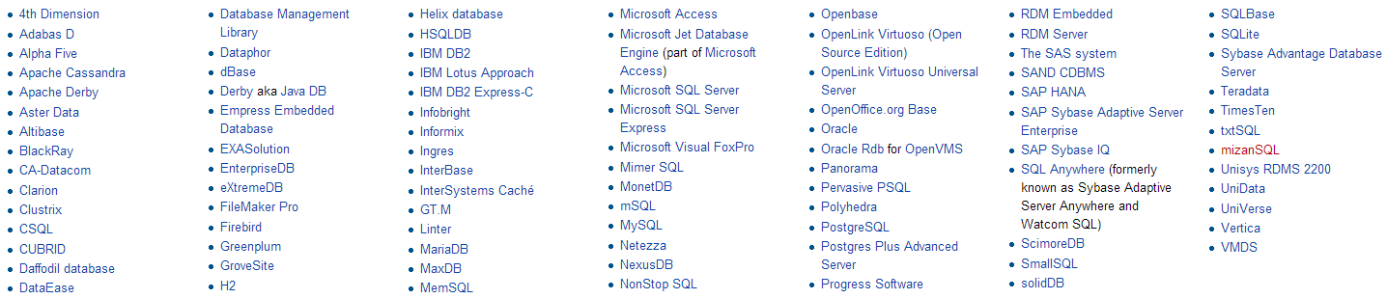
Databases that use Codd’s model

Slide 6
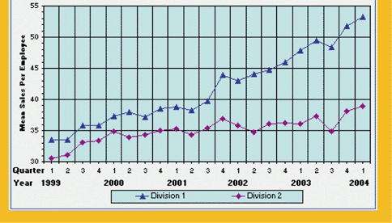
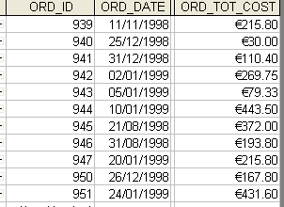
What’s the difference?

Slide 7
Marks Breakdown
Final Assessment is worth 60%
and the CA is worth 40%
All CA’s will take place during lab sessions.

Slide 8
Goals of the course
After completion students will be able to:
Design a Relational database(using Normalisation)
Create and query a database using SQL
Develop database applications
Develop applications with embedded SQL

Slide 9
Simplified Overview of Course
1: Relational Algebra
- SELECT
- PROJECT
- UNION
- INTERSECT
- JOIN
- CARTESIAN PRODUCT
2: Database design
- Normalisation 1 to 5
3: SQL
- DDL
- DML
4: ER Modelling
5: Java JDBC/ODBC

Slide 10
elearning.ait.ie
All Course information/notes will be placed up on the moodle server.
Notes for the next lecture will be placed on the server by the Monday evening.

Slide 11
Course Content
General Introduction
Definition of a DBMS
Advantages & Disadvantages
Architectures & Categories of DB
Relational Database Models
Tables, Tuples & Attributes
Integrity, Concurrency & Security
Relational Algebra
Union, Intersection
Difference

Slide 12
Course Content
Selection, Projection & Join
Cartesian Product, Join
SQL: A Relational Database Language
SQL Projection, Selection
Conditional Queries
Further SQL
Built in Functions
Group By

Slide 13
Course Content
Union, Join in SQL
Equijoin
Qualified Tests (ANY or ALL)
Union
Data Definition Language (DDL) in SQL
Create a table
Inset into, update & delete
Embedded SQL
Relational Database Design
Primary Key & Functional Dependency
Normalisation (1NF, 2NF)

Slide 14
Course Content
Third Normal Form
Transitive Dependency
3NF
Database Design
Database Lifecycle
Entities, E-R Diagrams
Database Design Methodology
Further Normal Forms
BCNF
4NF
5NF

Slide 15
Any Questions?

